Slide 1



TimeSeriesSets

Slide 2

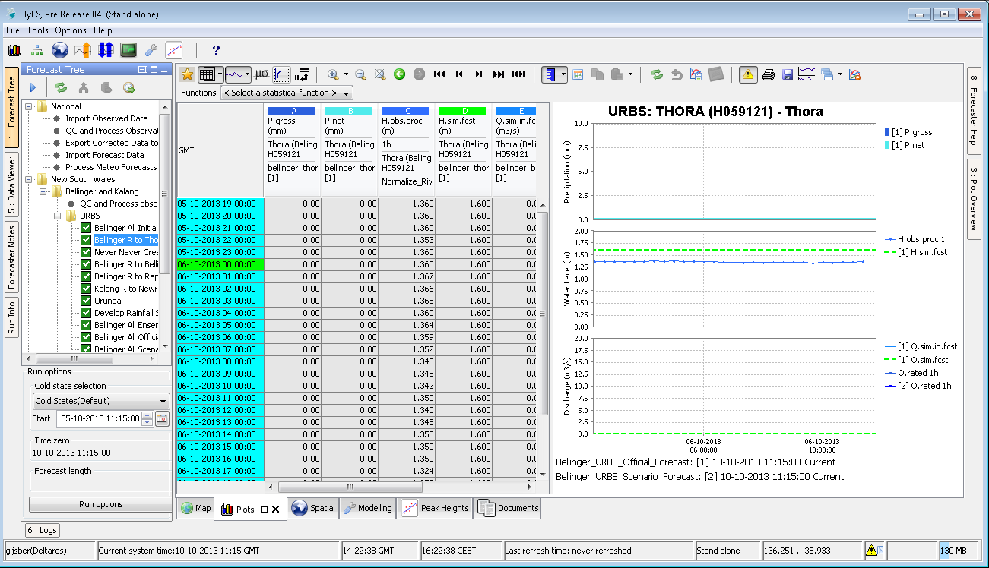
Time Series - What it’s all about
When ?
What ?
Where ?
When ?
Semantics
By Whom ?
Creation
numbers
How ?

Slide 3
Time Series - What it’s all about
Unit
What ?
Parameter
When ?
Time stamp
Where ?
Location
When ?
Task run
Semantics
By Whom ?
Workflow
Creation
numbers
How ?
Module instance

Slide 4
Time Series – FEWS concepts
Primary keys for time series identification:
Parameter: Define what the time series represents
Location: Defines where a time series value applies
Time step: Defines when a time series value applies
Time series type: Defines its behaviour in the system
Value type: Defines its internal data format
Module instance: Defines how a time series value is generated

Slide 5
Time Series – FEWS concepts
Primary keys for time series identification:
Parameter: Define what the time series represents
Location: Defines where a time series value applies
Time step: Defines when a time series value applies
Time series type: External or Simulated, and
Historical (continuous in time) or Forecasting (start time T0)
or Temporary
Value type: Defines its internal data format
Module instance: Defines how a time series value is generated

Slide 6
Time Series – external historical
Added incrementally
Can be edited by the user
Only new and changed values are stored
Time of import
Complete series
Manual edit
Complete series
10:00
07:00
04:00
00:00

Slide 7
Time Series – external forecasting
Added and stored individually
Can be edited by the user
Usage of series depends on T0
Time of Forecast
Series at 08:00
Series at 06:00
08:00
04:00
00:00
00:00
04:00
06:00
08:00

Slide 8
Time Series – simulated historical
Continuous in time
Referenced by the forecast model that produced them
Approved series shown automatically (including history)
Most often linked by model states
System Time
Series at 16:00
Series at 08:00
16:00
12:00
08:00
04:00
00:00
04:00
08:00
12:00
16:00

Slide 9
Time Series – simulated forecasting
Continuous in time (in combination with simulated historical)
Referenced by the forecast model that produced them
Approved and selected series can be viewed
System Time
Series at 12:00
12:00
08:00
04:00
00:00
04:00
08:00
12:00
16:00

Slide 10
Time Series – temporary
Referenced by the module instance that produced them
exist ONLY during the run that created the series
E.g. time series used in pre- / post-processing
module 1
module 1
module 2
temporary series
module 2
module 3
module 3
workflow 1
workflow 2
Notes:
10

Slide 11
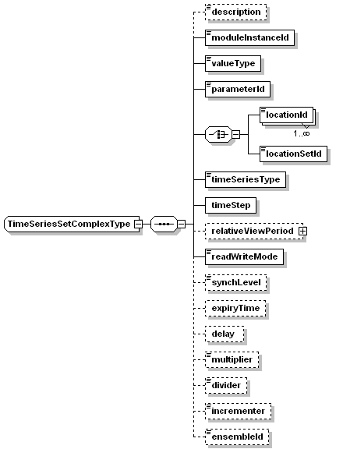
Time Series Sets
Properties of a timeSeriesSet
Some elements are only used when retrieving time series, other elements only when storing data
All data handling is done through Time Series Sets

Slide 12
Workflow – FEWS concepts
Module instance - defines processing step
Workflow - Logical sequence of module instances
Task run - Actual execution of a workflow
TimeserieSets connect the dataflow between the module instances
Import
Preprocess
Run Model
Post process
Archive
Export
Report

Slide 13
General Module layout
anyModule
Request data
from datastore
Do something …
Write data
to datastore

Slide 14
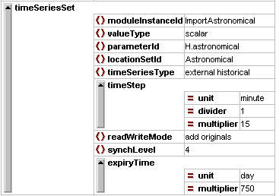
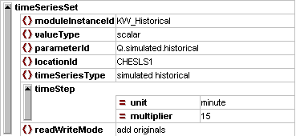
Time Series Sets - Examples
Import Run General Adapter Run

Slide 15
Importing data
Import Modules allows data from external sources to be imported
Various Scalars – e.g. PI XML and Wiski
ASCII grid time series
Binary GRIB (grid) and BIL time series
Currently around 50 data import types
FEWS imports files from directories specified in the global.properties file

Slide 16
Import Module
Key Features:
ID mapping > idMap.xml
Units mapping > unitConversion.xml
Flag mapping > flagConversions.xml
Tolerance: when imported data is not exactly observed at the cardinal time step
Time zone mapping: database stores all data in GMT, specify time zone when importing
Validate: Imported files can be validated against their own schema

Slide 17


Import Module & Id mapping
Matching ‘outside world’ to the ‘FEWS world’
locations (ids)
parameter (ids)
Three levels
direct mapping → location names AND parameter names differ
indirect → either location names or parameter names differ
1:1 → location and parameter names do NOT differ
Used when importing and exporting time series
Notes:
Id mapping files are in the id mapping folder and should be “registered” in the appropriate descriptors file.

Slide 18
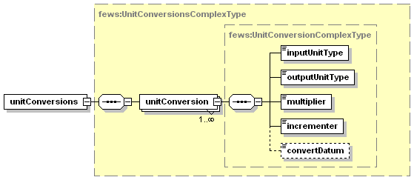
Import Module & Unit conversion
Map internal units to external units
Used when importing and exporting time series
Extra option to convert datum of level recordings (external unit mAOD)

Slide 19
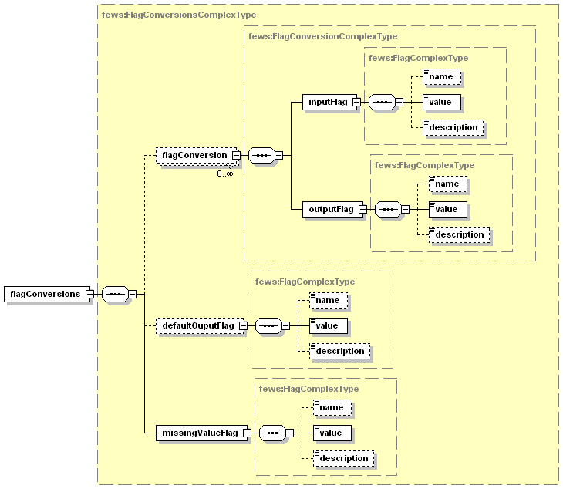
Import Module & Flag conversion
Map internal quality flags to external quality flags
Used when importing and exporting time series

Slide 20
Exercise
Exercise 5: Import time series
Add elements to ID mapping table
Run import workflow
Analyse data with the Time Series Display

Slide 21
Validating Data
Allow quality checking of all scalar time series data
Difference in hard limit and soft limit checks
Hard limit checks mark data as unreliable
Soft limit checks mark data as doubtful
Option to enter monthly limits
Specify rule for 1 time series or a complete set

Slide 22
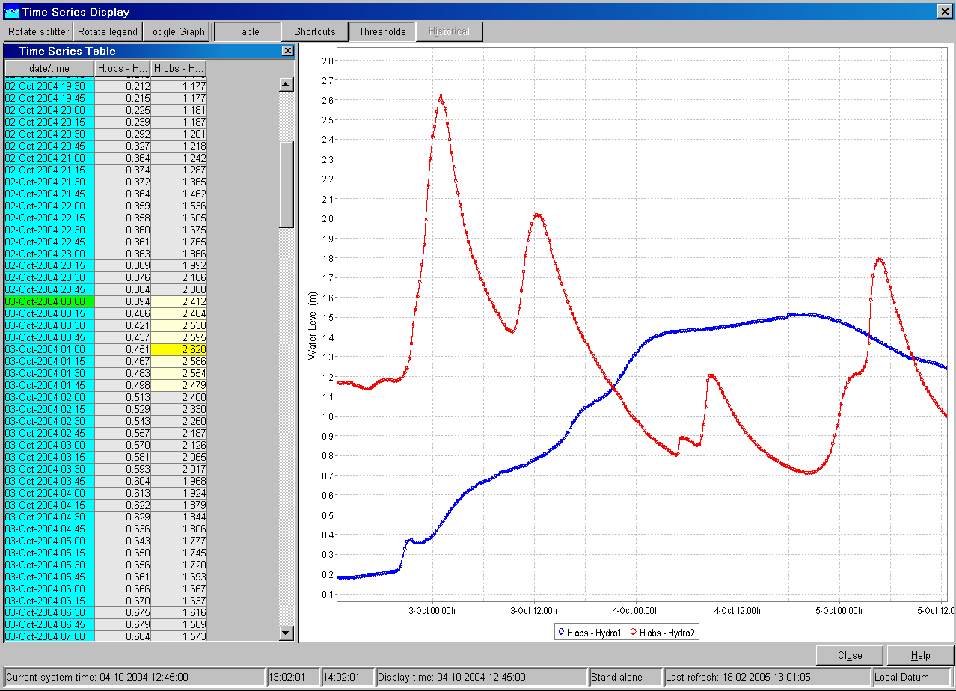

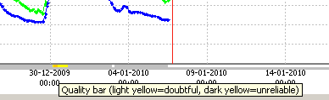
Exercise
Exercise 6: Add validation rules for imported data
Check the data just imported
Define validation rules
Enter the rules in the ValidationRuleSets XML file
Delete the data store
Run import workflow
View data
Check the difference!

